Slide 1
Elliptic Curve Cryptography (ECC)

Slide 2
Majority of public-key crypto (RSA, D-H) use either integer or polynomial arithmetic with very large numbers/polynomials imposes a significant load in storing and processing keys and messages.
public-key crypto (RSA, D-H) security is not guaranteed in the near future due to availability of massive computation power.
An alternative is to use elliptic curves offers same security with smaller bit sizes.

Slide 3
ECC performs the computations using elliptic curve arithmetic instead of integer or polynomial arithmetic.
The principal attraction of ECC, compared to RSA, is that it appears to offer better security for a far smaller key size, thereby reducing processing overhead.

Slide 4
An elliptic curve is the set of points that satisfy a specific mathematical equation.
An elliptic curve is defined by an equation in two variables x & y, with coefficients.
an elliptic curve is the set points satisfying an equation in two variables with degree two in one of the variables and three in the other.
Consider a cubic elliptic curve of form
y² = x³ + ax + b
where x,y,a,b are all real numbers
Elliptic curves are not ellipses. They are so named because they are described by cubic equations, similar to those used for calculating the circumference of an ellipse.

Slide 5
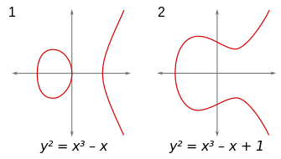

Slide 6
Elliptic curve properties
Any point on the curve can be reflected over the x axis and remain the same curve (horizontal symmetry).
Any non-vertical line will intersect the curve in at most three places. Take any two points on the curve and draw a line through them, it will intersect the curve at exactly one more place.
If you draw a line from A to B, the line will hit the curve at the third point C, when that happens the reflection (R) of the third point could be either straight up (if it's below the x-axis) or straight down (if it's above the x-axis) to the other side of the curve.

Slide 7
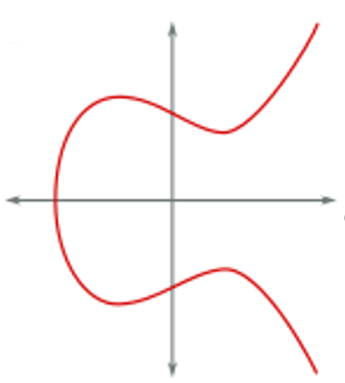
B
R
A
C
R
C
A
B
(1)
(2)

Slide 8
If you have two points, a line to cross them then to cross a third point, then from the reflection of the third to repeat the previous steps n times to finally arrive the a final point implies:
finding out n when you only know the final point and the first point is hard. Easy to do, hard to undo.
B
D
D
A
A
A
E
C
C
(1)
(2)
(3)

Slide 9
In practice, the choice of points values are restricted to numbers in a fixed range.
Rather than allow any value for the points on the curve, we restrict ourselves to whole numbers in a fixed range.
When computing the formula for the elliptic curve (y² = x³ + ax + b), we roll over the numbers (wrap around using %) when we hit the maximum of our range.
If the maximum to be a prime number, the elliptic curve is called a prime curve and has excellent cryptographic properties.

Slide 10
An elliptic curve cryptosystem can be defined by picking a prime number as a maximum, a curve equation and a public point on the curve.
A private key is a number priv, and a public key is the public point (A in the previous figure) crossing other points and back to itself priv times.
Computing the private key from the public key in this kind of cryptosystem is called the elliptic curve discrete logarithm function. Which is impossible to solve.

Slide 11
The elliptic curve discrete logarithm is the hard problem.
Despite almost three decades of research, mathematicians still haven't found an algorithm to solve this problem that improves upon the naive approach.
In other words, unlike with factoring (in RSA), there doesn't appear to be a shortcut that is narrowing the gap to the solution.
Solving elliptic curve discrete logarithms is significantly harder than factoring.

Slide 12
Since a more computationally intensive hard problem means a stronger cryptographic system, it means elliptic curve cryptosystems are harder to break than RSA and Diffie-Hellman.
Breaking a 228-bit RSA key requires less energy to than it takes to boil a teaspoon of water. Comparatively, breaking a 228-bit elliptic curve key requires enough energy to boil all the water on earth. For this level of security with RSA, you'd need a key with 2,380-bits.
ECC offers a better tradeoff: high security with short, fast keys.

Slide 13
In the definition of an elliptic curve is a single element denoted O and called the point at infinity or the zero point.
Now, consider the set of points E(a, b) consisting of all of the points (x, y) that satisfy this equation together with the element O.
Using a different value of the pair (a, b) results in a different set E(a, b).

Slide 14
The negative of a point P is the point with the same x coordinate but the negative of the y coordinate; that is, if P = (x, y), then –P = (x, –y). These two points can be joined by a vertical line.
O is the additive identity (infinity, zero). Thus O = –O; for any point P on the elliptic curve,
P + O = P, and P + (–P) = P – P = O.

Slide 15
Adding Two Points P and Q with Different x Coordinates
Draw a straight line between them.
Find the third point of intersection R.
There is a unique point -R that is the point of intersection.

Slide 16
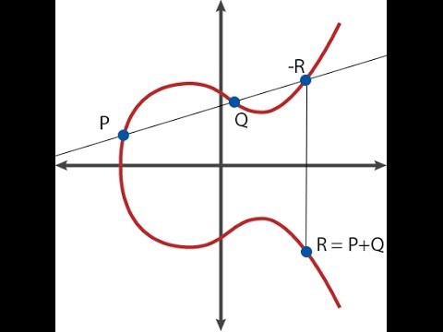

Slide 17
To form a group structure, we need to define addition on these three points as follows:
P + Q = –R. ie. P + Q to be the mirror image (with respect to the x axis) of the third point of intersection.
The addition operation for elliptic curve:
geometrically sum of P+Q is reflection of the intersection R.

Slide 18
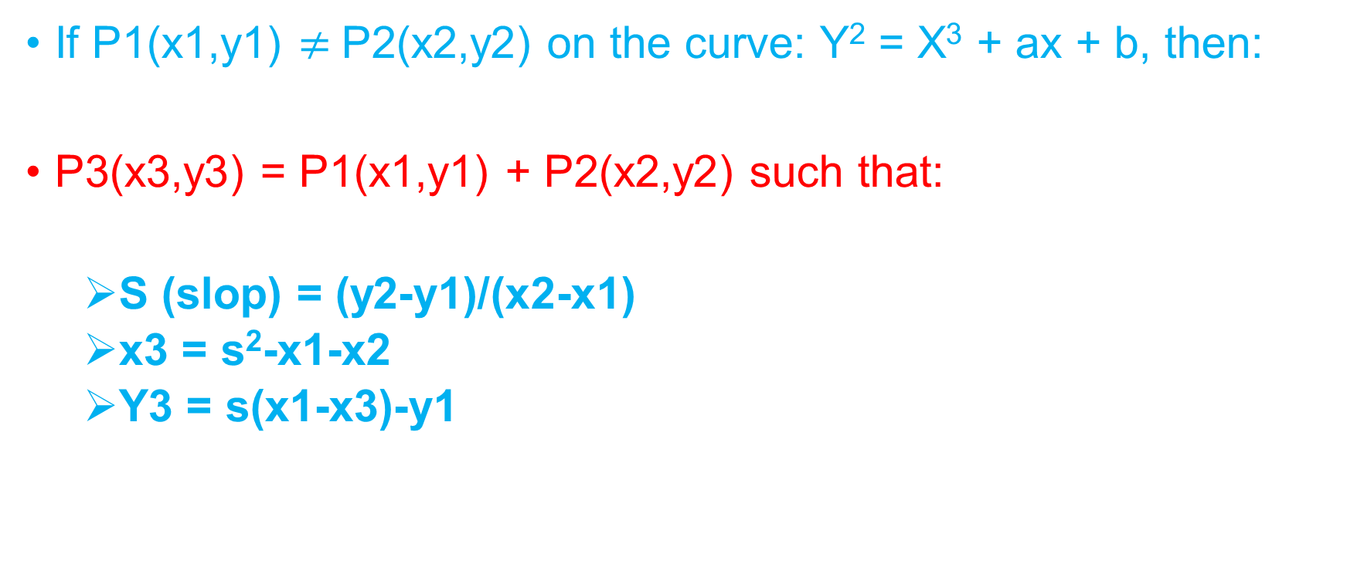
If P1(x1,y1) $≠$P2(x2,y2) on the curve: Y² = X³ + ax + b, then:
P3(x3,y3) = P1(x1,y1) + P2(x2,y2) such that:
S (slop) = (y2-y1)/(x2-x1)
x3 = s²-x1-x2
Y3 = s(x1-x3)-y1

Slide 19
Example
Y² = X³ + 5x + 7, what is (2,5) + (3,7)?
S= (7-5)/(3-2) = 2
X3 = 2² -2-3 = -1
Y3 = 2(2-(-1))-5=1
(2,5) + (3,7) = (-1,1)

Slide 20
If P1(x1,y1) = P2(x1,y1) on the curve: Y² = X³ + ax + b, then:
P3(x3,y3) = P1(x1,y1) + P2(x1,y1) such that:
S (slop) = (3*x1²+a)/(2*y1)
x3 = s²-2*x1
Y3 = s(x1-x3)-y1

Slide 21
The geometric interpretation of the preceding item also applies to two points, P and –P, with the same x coordinate.
The points are joined by a vertical line, which can be viewed as also intersecting the curve at the infinity point.
We therefore have P + (–P) = O.
To double a point Q, draw the tangent line and find the other point of intersection S. Then Q + Q = 2Q = –S.

Slide 22
Finite Elliptic Curves
Elliptic curve cryptography uses curves whose variables & coefficients are finite
Have two families commonly used:
prime curves E_{p}(a,b) defined over Z_{p}
use integers modulo a prime
best in software
binary curves E_{2m}(a,b) defined over GF(2^{n})
use polynomials with binary coefficients
best in hardware

Slide 23
The number of elements of a finite field is called its order.
A finite field of order q exists if and only if the order q is a prime power p^{k} (where p is a prime number and k is a positive integer).
The simplest examples of finite fields are the fields of prime order: for each prime number p, the prime field GF(p) of order (that is, size) p may be constructed as the integers modulo p.

Slide 24
ECC addition is analog of modulo multiply
ECC repeated addition is analog of modulo exponentiation
“hard” problem equiv to discrete log
Q=kP, where Q,P belong to a prime curve
is “easy” to compute Q given k,P
but “hard” to find k given Q,P
known as the elliptic curve logarithm problem
Certicom example: E₂₃(9,17)

Slide 25
For elliptic curves over Zp, as with real numbers, the coefficients and variables are limited to Zp:
Y² mod p = (x³ + ax + b) mod p
Example: a = 1, b =1, x =9, y=7, p=23:
7² mode 23 = (9³ + 9 + 1) mod 23
49 mod 23 = 739 mod 23
3 = 3

Slide 26
Consider the group E₂₃(9, 17). This is the group defined by the equation y² mod 23 = (x³ + 9x + 17) mod 23. What is the discrete logarithm k of Q = (4, 5) to the base P = (16, 5)?
The brute-force method is to compute multiples of P until Q is found. Thus P = (16, 5); 2P = (20, 20); 3P = (14, 14); 4P = (19, 20); 5P = (13, 10); 6P = (7, 3); 7P = (8, 7); 8P = (12, 17) ; 9P = (4, 5).
Because 9P = (4, 5) = Q, the discrete logarithm Q = (4, 5) to the base P = (16, 5) is k = 9.
In a real application, k would be so large as to make the brute-force approach infeasible.

Slide 27
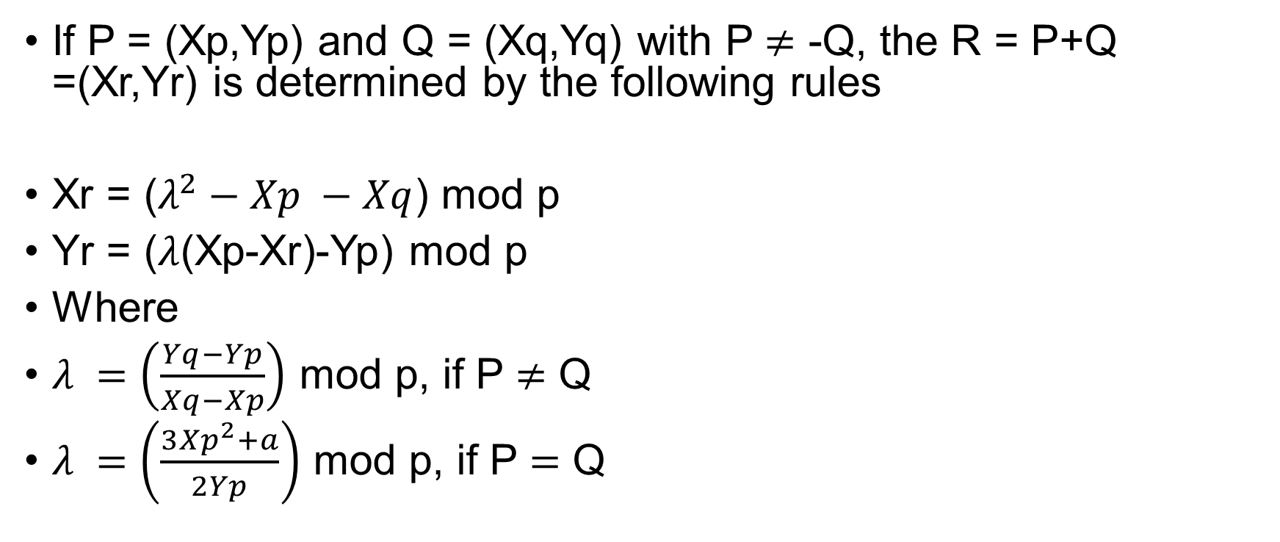
If P = (Xp,Yp) and Q = (Xq,Yq) with P $≠$ -Q, the R = P+Q =(Xr,Yr) is determined by the following rules
Xr = ($λ^{2}−Xp −Xq$) mod p
Yr = ($λ$(Xp-Xr)-Yp) mod p
Where
$λ =\left(\frac{Yq−Yp}{Xq−Xp}\right)$ mod p, if P $≠$ Q
$λ =\left(\frac{3{Xp}^{2}+a}{2Yp}\right)$ mod p, if P $=$ Q

Slide 28
Multiplication is defined as repeated addition, for example:
4P = P + P + P + P

